Slide 1

CSC415 Operating System Principles
Virtual Memory
Professor Hao Yue
Fall 2017

Slide 2

Outline
Background
Demand Paging
Page Replacement
Page Allocation
Thrashing
Memory-Mapped Files

Slide 3
Background
Memory-management strategies require that an entire process must be in memory before it can be executed
Limit the size of a program to the size of physical memory
However, in many cases, the entire program is not needed
Example: the code to handle unusual error conditions
Benefits to execute a program that is partially in memory
Programs are no longer constrained by the size of physical memory
Each program takes less memory while running

Slide 4
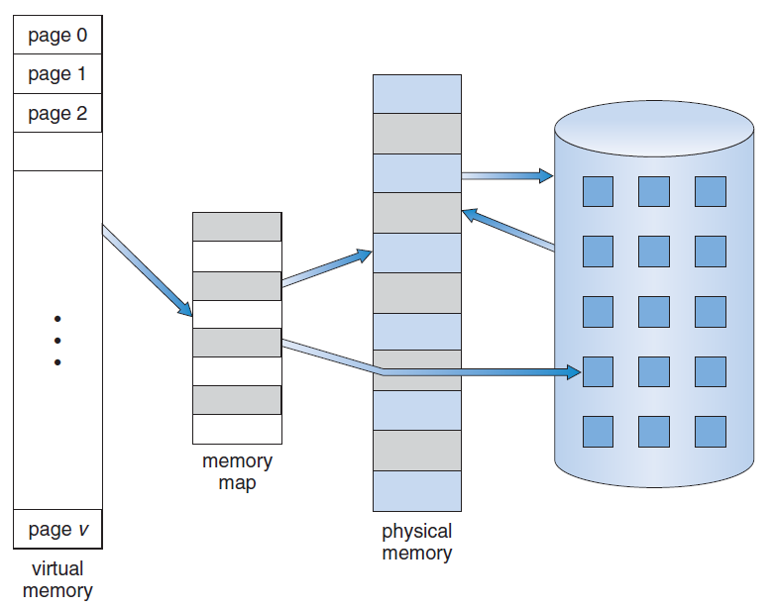
Virtual Memory
Idea: Parts of a program that are in use are in main memory, and the rest is on the disk
Logical address space can be much larger than physical address space

Slide 5
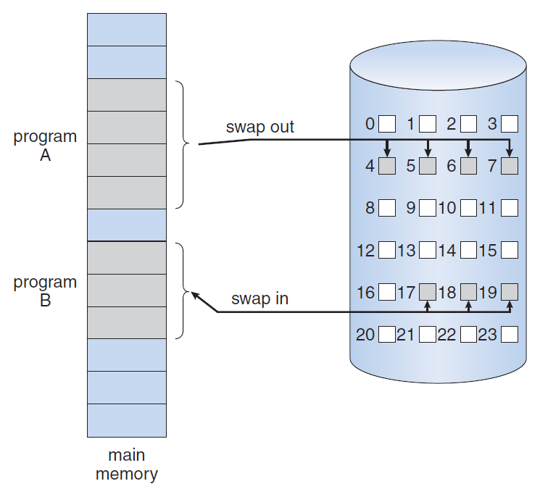
Demand Paging
Demand paging
Pages are loaded only when they are demanded during program execution
Pages that are never accessed are never loaded into physical memory
Swap needed pages, not the entire process

Slide 6
Demand Paging
Pager guesses which pages will be used and brings only those pages into memory
Hardware support to distinguish between the pages in memory and the pages on the disk
A valid-invalid bit is associated with each page table entry
“Valid” indicates the page is in memory
“Invalid” indicates the page is on the disk
Page fault occurs if “invalid” page is accessed during MMU address translation

Slide 7
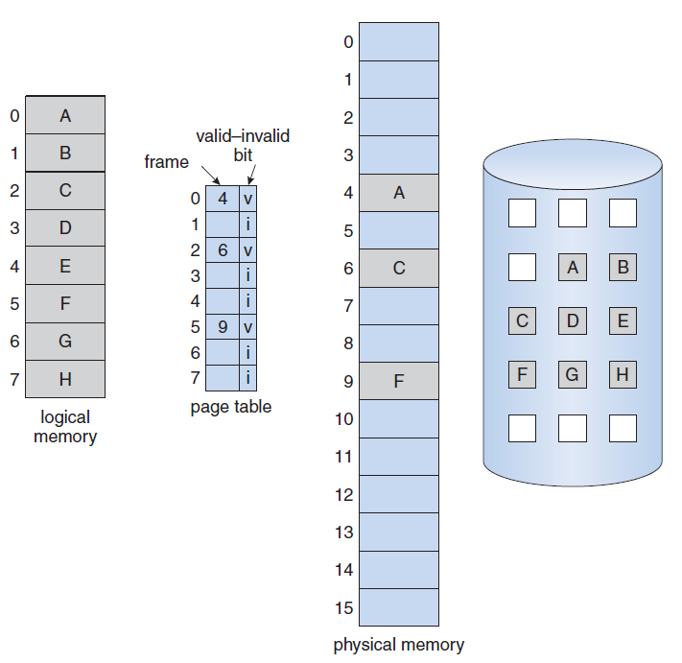
Demand Paging

Slide 8
Demand Paging
Procedure for handling the page fault caused by access to “invalid” page
OS determines whether the reference is a valid or an invalid memory access
If it is invalid access, we terminate the process
If it is valid but the page is not in memory, we page it in
Find a free frame
Read the page into the frame
Update the page table to indicate that the page is in memory
Restart the instruction that caused the page fault

Slide 9
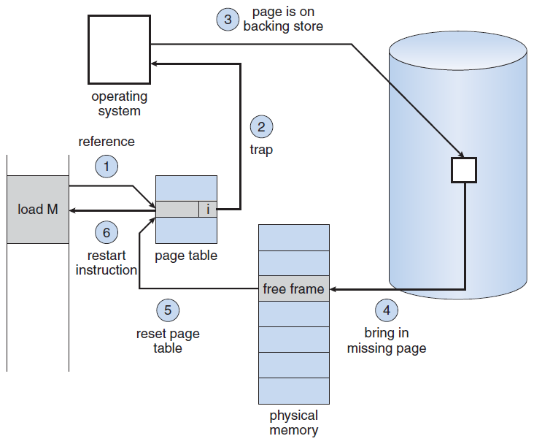
Demand Paging

Slide 10
Performance
Effective access time
It is equal to the memory access time (denoted as ma) when there is no page fault
Generally, it is equal to (1-p) × ma + p × page fault time
Example: ma = 200 nanoseconds, page-fault time = 8 milliseconds
Effective access time
= (1-p) × 200 + p × (8×10⁶)
= 200 + p × 7,999,800
Need to minimize the page-fault rate in a demand paging system

Slide 11
Demand Paging
Frame-allocation algorithms
Determine how many frames to allocate to each process
Page-replacement algorithms
Select a page to be replaced when the desired page needs to be read into memory but there are no free frames
The goal is to minimize the page-fault rate

Slide 12
Page Replacement
Basic page replacement
If no frame is free, find one that is not currently used and free it
Page fault service routine with page replacement
Find the location of desired page on the disk
Find a free frame
If there is a free frame, use it
If there is no free frame, use a page-replacement algorithm to select a victim frame
Write the victim frame to the disk; update the page and frame tables
Read the desired page into the free frame; update the page and frame tables
Continue the process from where the page fault occurred

Slide 13
Page Replacement Algorithms
Page-replacement algorithms: select the frames to be replaced
Different page-replacement algorithms have different performance
Choose the one with the lowest page-fault rate
Evaluate the algorithms by running them on a particular string of memory references (called reference string)
Use the page number, rather than the entire address
Delete repeated access to the same page since it does not cause a page fault
The performance also depends on the number of frames available
In all the following examples, we consider a memory with three frames and use the reference string 7, 0, 1, 2, 0, 3, 0, 4, 2, 3, 0, 3, 2, 1, 2, 0, 1, 7, 0, 1

Slide 14
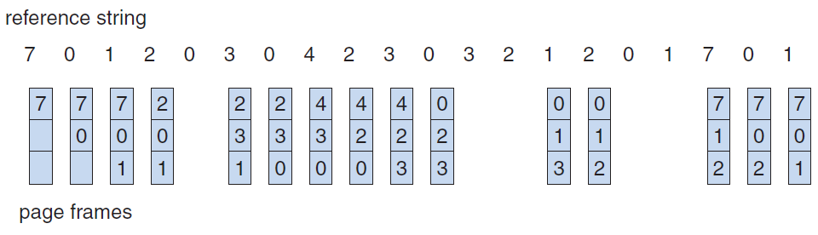
FIFO Page Replacement
First-in, first-out (FIFO) algorithm
Choose the oldest page to replace
Performance is not always good
Number of page faults = 15

Slide 15
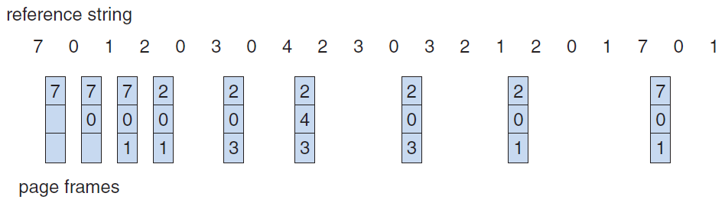
Optimal Page Replacement
Optimal (OPT) algorithm
Replace the page that will not be used for the longest time
Guarantee the lowest page-fault rate for a fixed number of frames
Number of page faults = 9
OPT is difficult to implement, since it requires future knowledge of the reference string

Slide 16
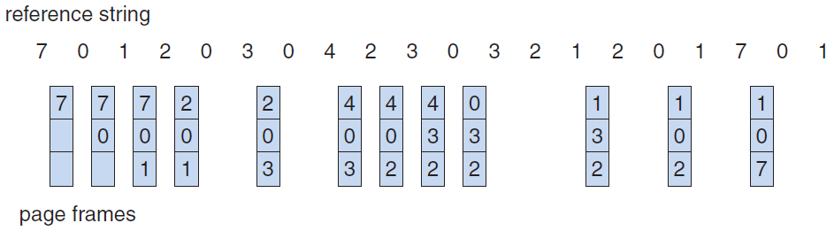
LRU Page Replacement
Least Recently Used (LRU) algorithm
Use the recent past as an approximation of the near future
Replace the page that has not been used for the longest time
Number of page faults = 12

Slide 17
Frame Allocation
How do we allocate the fixed amount of free memory among processes?
Maximum: the total number of available frames
Minimum: enough frames to hold all the different pages that any single instruction can reference
Allocation algorithms
Equal allocation
Proportional allocation

Slide 18
Frame Allocation
Equal allocation
Split m frames among n processes and each process obtains an equal share m/n frames
Example: there are 100 frames and 5 processes. Each process receives 20 frames.
Proportional allocation
Allocate frames according to the size of processes
Let s_{i} be the size of process p_{i} and m be the total number of free frames, the number of frames allocated to p_{i} is m × s_{i}/∑s_{i}
Sometimes need to adjust the result to be an integer that is greater than the minimum number of frames required by the process

Slide 19
Frame Allocation
Page replacement also affects frame allocation
Global replacement
A process can select a victim frame from the set of all frames, i.e., one process can take a frame from another
E.g., High-priority processes can take frames form low-priority processes for replacement
Advantage: higher system throughput
Local replacement
Each process selects from only its own set of allocated frames
The number of frames allocated to a process does not change
Advantage: the performance of a process is more consistent

Slide 20
Thrashing
What would occur if a process does not have enough frames?
Page-fault and replace a page in active use
Page-fault again because the replaced page is needed right away
High page-fault rate
Thrashing
A process is spending more time paging than executing
Will lead to severe performance problem
Assume that a process needs more frames and take frames from other processes
However, those frames are in use, and hence those processes fault and take frames from each other
CPU utilization decreases and CPU scheduler will increase the degree of multiprogramming by adding new processes to the ready queue

Slide 21
Working-Set Model
We must provide a process with as many frames as it needs to prevent thrashing
Different methods to estimate the number of frames a process needs
Working-Set model
Page-fault frequency
Working-Set model
Based on the locality model
A locality is a set of pages that are actively used together
As a process executes, it moves from locality to locality
E.g., when a function is called, it defines a new locality, where memory references are made to the instructions, local variables, and a subset of global variables

Slide 22
Working-Set Model
Define the working-set window Δ
The working set is the set of pages in the most recent Δ page references
If Δ is too small, it cannot encompass the entire locality
If Δ is too large, it will overlap several localities
Define WSS_{i} as the total number of pages in the working set of Process P_{i}
Thrashing will occur when D>m, where D=∑WSS_{i} is the total demand for frames and m is the total number of available frames
When D>m, swap out a process and releases its frames

Slide 23
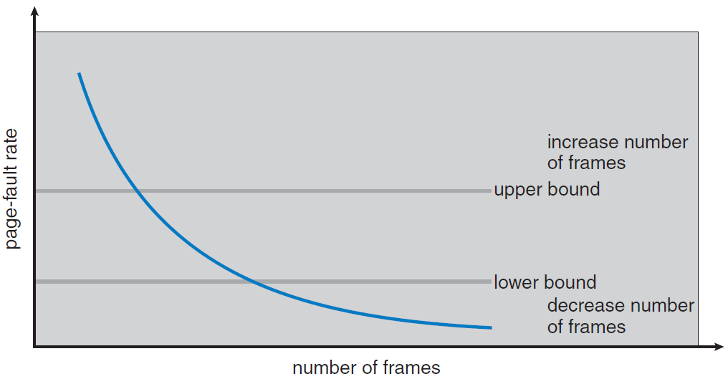
Page-Fault Frequency
Idea: measure and control the page-fault rate to prevent thrashing
Establish upper and lower bounds on the desired page-fault rate
If the actual page-fault rate is too high, allocate another frame to the process
If the actual page-fault rate is too low, remove a frame from the process

